Slide 1

OPEN SOURCE MOBILE PLATFORM
ANDROID INPUT CONTROLS

Slide 2


Slide 3
ANDROID UI Elements
A View is an object that draws something on the screen that the user can interact with and a ViewGroup is an object that holds other View (and ViewGroup) objects in order to define the layout of the user interface.
You define your layout in an XML file which offers a human-readable structure for the layout, similar to HTML. For example, a simple vertical layout with a text view and a button looks like this −
<?xml version="1.0" encoding="utf-8"?>
<LinearLayout xmlns:android="http://schemas.android.com/apk/res/android"
android:layout_width="fill_parent"
android:layout_height="fill_parent"
android:orientation="vertical" >
<TextView android:id="@+id/text"
android:layout_width="wrap_content"
android:layout_height="wrap_content"
android:text="I am a TextView" />
<Button android:id="@+id/button"
android:layout_width="wrap_content"
android:layout_height="wrap_content"
android:text="I am a Button" />
</LinearLayout>

Slide 4
ANDROID INPUT CONTROLS
Progress Bar
Checkboxes
Radio Buttons
Radio Group
Toggle Buttons
Time Picker
Date Picker
Text View
Edittext
Auto Complete Text View
Button
ImageButton
Spinner

Slide 5
ANDROID UI Control & Description
1.TextView
This control is used to display text to the user.
2.EditText
EditText is a predefined subclass of TextView that includes rich editing capabilities.
3.AutoCompleteTextView
The AutoCompleteTextView is a view that is similar to EditText, except that it shows a list of completion suggestions automatically while the user is typing.
4.Button
A push-button that can be pressed, or clicked, by the user to perform an action.
5.ImageButton
An ImageButton is an AbsoluteLayout which enables you to specify the exact location of its children. This shows a button with an image (instead of text) that can be pressed or clicked by the user.

Slide 6
ANDROID
6.CheckBox
An on/off switch that can be toggled by the user. You should use check box when presenting users with a group of selectable options that are not mutually exclusive.
7.ToggleButton
An on/off button with a light indicator.
8.RadioButton
The RadioButton has two states: either checked or unchecked.
9.RadioGroup
A RadioGroup is used to group together one or more RadioButtons.

Slide 7
ANDROID
10.ProgressBar
The ProgressBar view provides visual feedback about some ongoing tasks, such as when you are performing a task in the background.
11.Spinner
A drop-down list that allows users to select one value from a set.
12.TimePicker
The TimePicker view enables users to select a time of the day, in either 24-hour mode or AM/PM mode.
13.DatePicker
The DatePicker view enables users to select a date of the day.

Slide 8
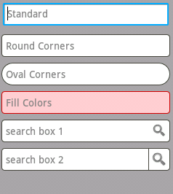
Edit Text View
A EditText is an overlay over TextView that configures itself to be editable. It is the predefined subclass of TextView that includes rich editing capabilities.
EditText Attributes
Following are the important attributes related to EditText control. You can check Android official documentation for complete list of attributes and related methods which you can use to change these attributes are run time.

Slide 9
Edit Text View
Inherited from android.widget.TextView Class −
Sr.No | Attribute & Description
1 | android:autoText If set, specifies that this TextView has a textual input method and automatically corrects some common spelling errors.
2 | android:drawableBottom This is the drawable to be drawn below the text.
3 | android:drawableRight This is the drawable to be drawn to the right of the text.
4 | android:editable If set, specifies that this TextView has an input method.
5 | android:text This is the Text to display.

Slide 10
Edit Text View
Inherited from android.view.View Class −
Sr.No | Attribute & Description
1 | android:background This is a drawable to use as the background.
2 | android:contentDescription This defines text that briefly describes content of the view.
3 | android:id This supplies an identifier name for this view.
4 | android:onClick This is the name of the method in this View's context to invoke when the view is clicked.
5 | android:visibility This controls the initial visibility of the view.

Slide 11
Auto Complete Text View
A AutoCompleteTextView is a view that is similar to EditText, except that it shows a list of completion suggestions automatically while the user is typing.
The list of suggestions is displayed in drop down menu. The user can choose an item from there to replace the content of edit box with.

Slide 12
Auto Complete Text View
AutoCompleteTextView Attributes
Following are the important attributes related to AutoCompleteTextView control. You can check Android official documentation for complete list of attributes and related methods which you can use to change these attributes are run time.
1 | android:completionHint This defines the hint displayed in the drop down menu.
2 | android:completionHintView This defines the hint view displayed in the drop down menu.
3 | android:completionThreshold This defines the number of characters that the user must type before completion suggestions are displayed in a drop down menu.
4 | android:dropDownAnchor This is the View to anchor the auto-complete dropdown to.

Slide 13
Auto Complete Text View
5 | android:dropDownHeight This specifies the basic height of the dropdown.
6 | android:dropDownHorizontalOffset The amount of pixels by which the drop down should be offset horizontally.
7 | android:dropDownSelector This is the selector in a drop down list.
8 | android:dropDownVerticalOffset The amount of pixels by which the drop down should be offset vertically.
9 | android:dropDownWidth This specifies the basic width of the dropdown.
10 | android:popupBackground This sets the background.

Slide 14
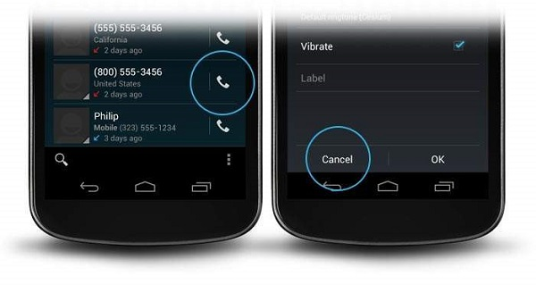
BUTTONS
A Button is a Push-button, that can be pressed or clicked by the user to perform an action.

Slide 15

BUTTONS
A button consists of text or an icon (or both text and an icon) that communicates what action occurs when the user touches it.
Depending on whether you want a button with text, an icon, or both, you can create the button in your layout in 3 ways:
1. With text, using the Button class:
<Button android:layout_width="wrap_content" android:layout_height="wrap_content" android:text="@string/button_text" ... />

Slide 16
BUTTONS
2. With an icon, using the ImageButton class:
<ImageButton
android:layout_width="wrap_content"
android:layout_height="wrap_content"
android:src="@drawable/button_icon"
... />
3. With text and an icon, using the Button class with the android:drawableLeft attribute:
<Button
android:layout_width="wrap_content"
android:layout_height="wrap_content"
android:text="@string/button_text"
android:drawableLeft="@drawable/button_icon"
... />

Slide 17
BUTTONS
Inherited from android.view.View Class −
Attribute Description
1. android:background
This is a drawable to use as the background.
2. android:contentDescription
This defines text that briefly describes content of the view.
3. android:id
This supplies an identifier name for this view.

Slide 18
BUTTONS
4. android:onClick
This is the name of the method in this View's context to invoke when the view is clicked.
5. android:visibility
This controls the initial visibility of the view.

Slide 19
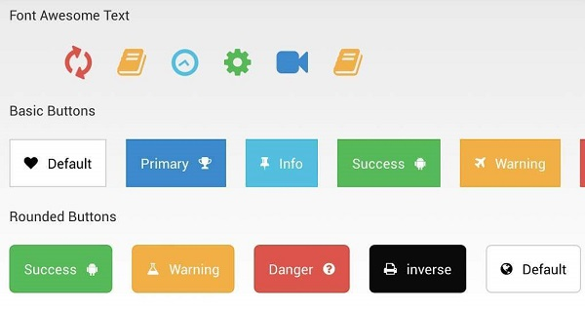
IMAGE BUTTON
An ImageButton is one which enables you to specify the exact location of the image. This shows a button with an image (instead of text) that can be pressed or clicked by the user.

Slide 20
IMAGE BUTTON
Inherited from android.widget.ImageView Class −
Sr.No | Attribute & Description
1 | android:adjustViewBounds This is set to true if we need to adjust the ImageView to its bounds to preserve the aspect ratio of its drawable.
2 | android:baseline This is the offset of the baseline within this view.
3 | android:baselineAlignBottom If true, the image view will be baseline aligned based on its bottom edge.
4 | android:cropToPadding If true, the image will be cropped to fit within its padding.
5 | android:src This sets a drawable as the content of this ImageView.

Slide 21
IMAGE BUTTON
Inherited from android.view.View Class −
Sr.No | Attribute & Description
1 | android:background This is a drawable to use as the background.
2 | android:contentDescription This defines text that briefly describes content of the view.
3 | android:id This supplies an identifier name for this view
4 | android:onClick This is the name of the method in this View's context to invoke when the view is clicked.
5 | android:visibility This controls the initial visibility of the view.

Slide 22
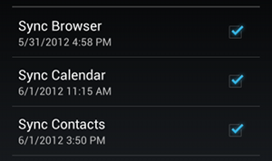
Check Box
Checkboxes allow the user to select one or more options from a set. Typically, you should present each checkbox option in a vertical list.
To create each checkbox option, create a CheckBox in your layout. Because a set of checkbox options allows the user to select multiple items, each checkbox is managed separately and you must register a click listener for each one.

Slide 23
Check Box
Inherited from android.view.View Class −
Sr.No | Attribute & Description
1 | android:background This is a drawable to use as the background.
2 | android:contentDescription This defines text that briefly describes content of the view.
3 | android:id This supplies an identifier name for this view.
4 | android:onClick This is the name of the method in this View's context to invoke when the view is clicked.
5 | android:visibility This controls the initial visibility of the view.

Slide 24
Check Box
<?xml version="1.0" encoding="utf-8"?> <LinearLayout xmlns:android="http://schemas.android.com/apk/res/android" android:orientation="vertical" android:layout_width="fill_parent" android:layout_height="fill_parent"> <CheckBox android:id="@+id/checkbox_meat" android:layout_width="wrap_content" android:layout_height="wrap_content" android:text="@string/meat" android:onClick="onCheckboxClicked"/> <CheckBox android:id="@+id/checkbox_cheese" android:layout_width="wrap_content" android:layout_height="wrap_content" android:text="@string/cheese" android:onClick="onCheckboxClicked"/> </LinearLayout>

Slide 25
public void onCheckboxClicked(View view) {
// Is the view now checked?
boolean checked = ((CheckBox) view).isChecked();
// Check which checkbox was clicked
switch(view.getId()) {
case R.id.checkbox_meat:
if (checked)
// Put some meat on the sandwich
else
// Remove the meat
break;
case R.id.checkbox_cheese:
if (checked)
// Cheese me
else
// I'm lactose intolerant
break;
// TODO: Veggie sandwich
}
}

Slide 26

Radio Button
Radio buttons allow the user to select one option from a set. You should use radio buttons for optional sets that are mutually exclusive if you think that the user needs to see all available options side-by-side. If it's not necessary to show all options side-by-side, use a spinner instead.

Slide 27
RadioGroup
A RadioGroup class is used for set of radio buttons.
If we check one radio button that belongs to a radio group, it automatically unchecks any previously checked radio button within the same group.
Attribute | Description
android:checkedButton | This is the id of child radio button that should be checked by default within this radio group.

Slide 28
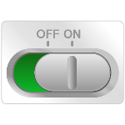

Toggle Buttons
A toggle button allows the user to change a setting between two states.
You can add a basic toggle button to your layout with the ToggleButton object. Android 4.0 (API level 14) introduces another kind of toggle button called a switch that provides a slider control, which you can add with a Switch object.
If you need to change a button's stat, you can use the below functions CompoundButton.setChecked() or CompoundButton.toggle() methods.

Slide 29
Toggle Buttons
To detect when the user activates the button or switch, create an CompoundButton.OnCheckedChangeListener object and assign it to the button by calling setOnCheckedChangeListener(). For example:
ToggleButton toggle = (ToggleButton) findViewById(R.id.togglebutton);
toggle.setOnCheckedChangeListener(new CompoundButton.OnCheckedChangeListener() {
public void onCheckedChanged(CompoundButton buttonView, boolean isChecked) {
if (isChecked) {
// The toggle is enabled
} else {
// The toggle is disabled
}
}
});

Slide 30
Progress Bar
Progress bars are used to show progress of a task. For example, when you are uploading or downloading something from the internet, it is better to show the progress of download/upload to the user.
In android there is a class called ProgressDialog that allows you to create progress bar. In order to do this, you need to instantiate an object of this class.
Its syntax is:
ProgressDialog progress = new ProgressDialog(this);

Slide 31
Progress Bar
properties of this dialog. Such as, its style, its text etc.
progress.setMessage("Downloading Music :) ");
progress.setProgressStyle(ProgressDialog.STYLE_HORIZONTAL);
progress.setIndeterminate(true);

Slide 32
Progress Bar
1 | getMax() This method returns the maximum value of the progress.
2 | incrementProgressBy(int diff) This method increments the progress bar by the difference of value passed as a parameter.
3 | setIndeterminate(boolean indeterminate) This method sets the progress indicator as determinate or indeterminate.
4 | setMax(int max) This method sets the maximum value of the progress dialog.
5 | setProgress(int value) This method is used to update the progress dialog with some specific value.
6 | show(Context context, CharSequence title, CharSequence message) This is a static method, used to display progress dialog.

Slide 33
public void download(View view){
progress=new ProgressDialog(this);
progress.setMessage("Downloading Music");
progress.setProgressStyle(ProgressDialog.STYLE_HORIZONTAL);
progress.setIndeterminate(true);
progress.setProgress(0);
progress.show();
final int totalProgressTime = 100;
final Thread t = new Thread() {
@Override
public void run() {
int jumpTime = 0;
while(jumpTime < totalProgressTime) {
try {
sleep(200);
jumpTime += 5;
progress.setProgress(jumpTime);
} catch (InterruptedException e) {
e.printStackTrace();
}
}
}
};
t.start();
}
}

Slide 34
Progress Bar
properties of this dialog. Such as, its style, its text etc.
progress.setMessage("Downloading Music :) ");
progress.setProgressStyle(ProgressDialog.STYLE_HORIZONTAL);
progress.setIndeterminate(true);

Slide 35
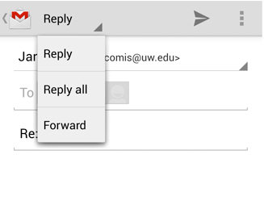
Spinner
Spinner allows you to select an item from a drop down menu
For example. When you are using Gmail application you would get drop down menu as shown below, you need to select an item from a drop down menu.

Slide 36
Spinner
Spinner spinner = (Spinner) findViewById(R.id.spinner);
// Spinner click listener
spinner.setOnItemSelectedListener(this);
// Spinner Drop down elements
List<String> categories = new ArrayList<String>();
categories.add("Automobile");
categories.add("Business Services");
categories.add("Computers");
categories.add("Education");
categories.add("Personal");
categories.add("Travel");
// Creating adapter for spinner
ArrayAdapter<String> dataAdapter = new ArrayAdapter<String>(this, android.R.layout.simple_spinner_item, categories);
// Drop down layout style - list view with radio button
dataAdapter.setDropDownViewResource(android.R.layout.simple_spinner_dropdown_item);
// attaching data adapter to spinner
spinner.setAdapter(dataAdapter);

Slide 37
Spinner
public void onItemSelected(AdapterView<?> parent, View view, int position, long id) {
// On selecting a spinner item
String item = parent.getItemAtPosition(position).toString();
// Showing selected spinner item Toast.makeText(parent.getContext(), "Selected: " + item, Toast.LENGTH_LONG).show();
}
<Spinner
android:id="@+id/spinner"
android:layout_width="fill_parent"
android:layout_height="wrap_content"
android:prompt="@string/spinner_title"/>

Slide 38
Spinner
For instance, if the available choices for your spinner are pre-determined, you can provide them with a string array defined in a string resource file:
<resources>
<string-array name="planets_array">
<item>Mercury</item>
<item>Venus</item>
<item>Earth</item>
<item>Mars</item>
<item>Jupiter</item>
<item>Saturn</item>
<item>Uranus</item>
<item>Neptune</item>
</string-array>
</resources>
Spinner spinner = (Spinner) findViewById(R.id.spinner);
// Create an ArrayAdapter using the string array and a default spinner layout
ArrayAdapter<CharSequence> adapter = ArrayAdapter.createFromResource(this,
R.array.planets_array, android.R.layout.simple_spinner_item);
// Specify the layout to use when the list of choices appears
adapter.setDropDownViewResource(android.R.layout.simple_spinner_dropdown_item);
// Apply the adapter to the spinner
spinner.setAdapter(adapter);

Slide 39
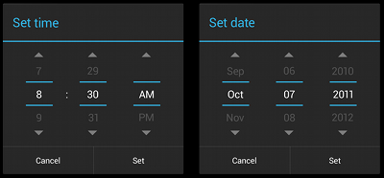
Pickers
Android provides controls for the user to pick a time or pick a date as ready-to-use dialogs. Each picker provides controls for selecting each part of the time (hour, minute, AM/PM) or date (month, day, year). Using these pickers helps ensure that your users can pick a time or date that is valid, formatted correctly, and adjusted to the user's locale

Slide 40
Pickers
android:text="@string/pick_time"
android:text="@string/pick_date"
public Dialog onCreateDialog(Bundle savedInstanceState) {
// Use the current date as the default date in the picker
final Calendar c = Calendar.getInstance();
int year = c.get(Calendar.YEAR);
int month = c.get(Calendar.MONTH);
int day = c.get(Calendar.DAY_OF_MONTH);
// Create a new instance of DatePickerDialog and return it
return new DatePickerDialog(getActivity(), this, year, month, day);
}

